Slide 1
Handling tags within AF when in a non-English environment
There are only differently wrong answers.

Slide 2
The problem

Slide 3
Examples use Japanese
工場 = Factory (Element)
センサー = Sensor (Attribute)
The ー in センサー is one the characters that cannot be used in tag names.

Slide 4
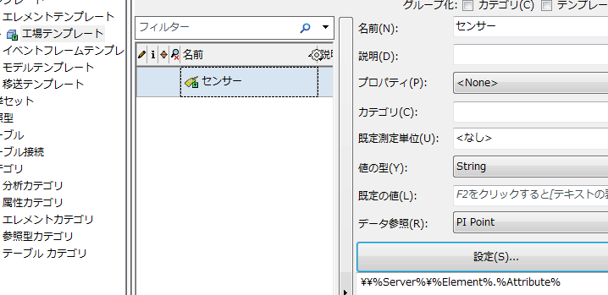
The problem this leads to
If one uses an AF Template with an attribute name such as センサー, then the automatic tag referencing will not work. Neither when creating tags or looking one up.

Slide 5
Impossible to avoid such characters
The ー in センサー is one of top ten most frequently used Japanese characters.
The list of characters that cannot be used is base on the way characters are encoded, thus it is really impossible for a user to practically avoid using such characters.

Slide 6
6 ways to deal with them

Slide 7
Method: Use English for AF element name attribute (i.e. don’t use Japanese)
As tag names only really properly handle English characters and other long standing encoding issues. It might be best to simply use English everywhere in AF.

Slide 8
How to do so:
Using all the default ways to refer to tags. That is, have access to all string references that are made available.

Slide 9
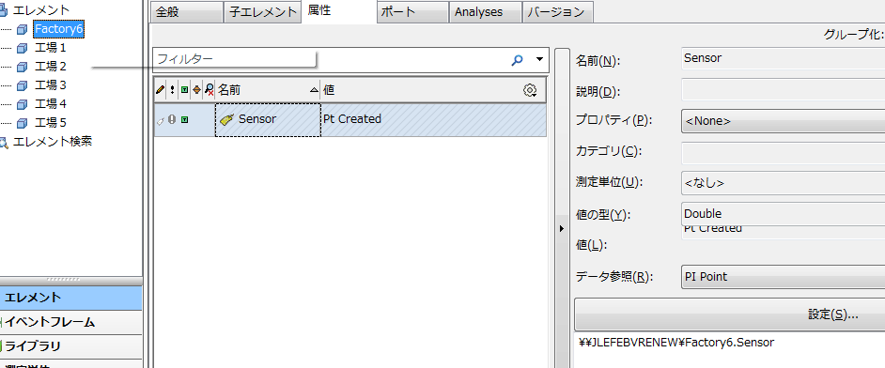
Result:
Resulting tag name: Factory6.Sensor

Slide 10
Pros
Cons
By far the easiest option.
The best supported option.
Great for existing customers who already have a large amount of tags.
Customers in Japan already use this strategy
Everything is in English.

Slide 11
Method: All tags name are manually selected
The tag names and AF structures are divorced enough not to be able to use tag naming

Slide 12
How to do so:
…

Slide 13
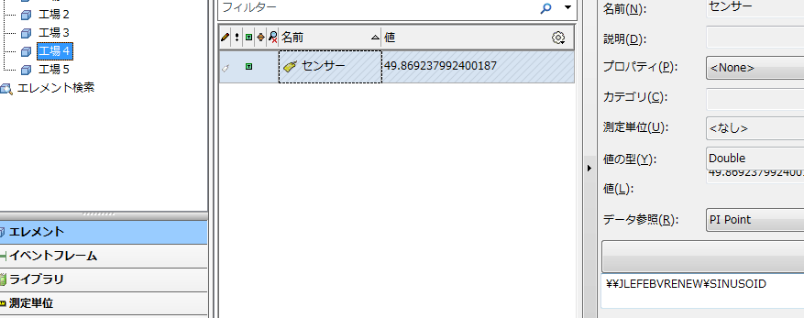
Result:
Resulting tag name: Sinusoid

Slide 14
Pros
Cons
Can be quickly used as it requires no planning.
Already used by existing customers.
Misses out on a big feature of AF.

Slide 15
Method: Encoding the tag names (タグ名＝Tag name)
Trying, in AF, to handle all the characters that cannot be used and encoding them in some way.

Slide 16
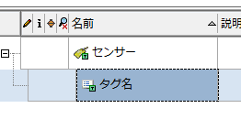
How to do so:
Child attribute of the attribute to handle the conversion.
The conversion can be done with a string builder, going over each character. This would have to be nested for each character that needs to be encoded.
A much better solution would be to use a custom data reference to replace the string builder.
T;Replace(%Element%,"ー","30FC");Replace(%..|attribute%,"ー","30FC");;
Tag names cannot start with a Japanese character, thus forced to add in a placeholder such as adding in the letter “T”.

Slide 17
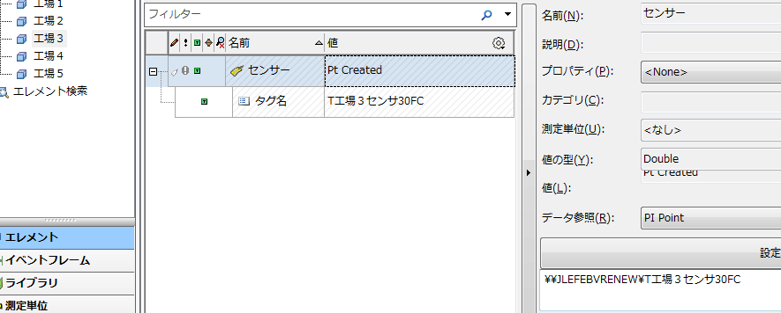
Result:
Resulting tag name: T工場３センサ30FC

Slide 18
Pros
Cons
Allows Japanese to be used in tag names
Useful when you only sometimes needs to look at tag names
The Japanese being used is really garbage
The custom data reference must be built
Tag names are handled differently base on the user local, thus, changing to a different local could mean you can no longer access tags

Slide 19
Method: Abuse the description field
Store all the information regarding tag names into the description field of elements and attributes

Slide 20
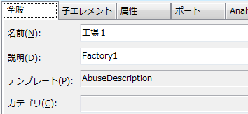
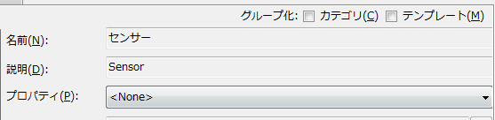
How to do so:
To refer to the tag name, you must then access the various description field:
%ElementDescription%.%Description%
In elements and attributes’ description field, store a translation of the name of elements

Slide 21
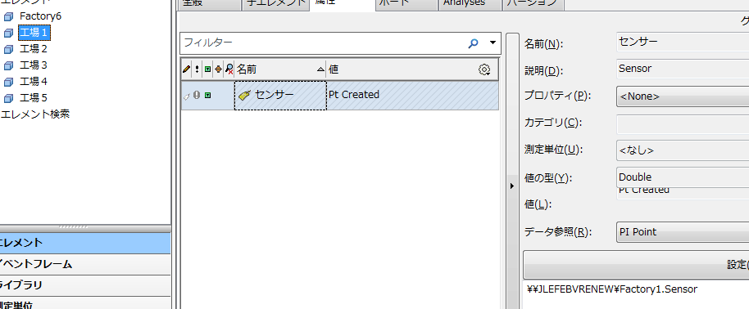
Result:
Resulting tag name: Factory1.Sensor

Slide 22
Pros
Cons
Gives good tag names.
Can be used by existing customers.
Lose the use of the description field
Doubles the effort of creating an element

Slide 23
Method: Using table look up
Store all the information regarding tag names in an AF Table

Slide 24
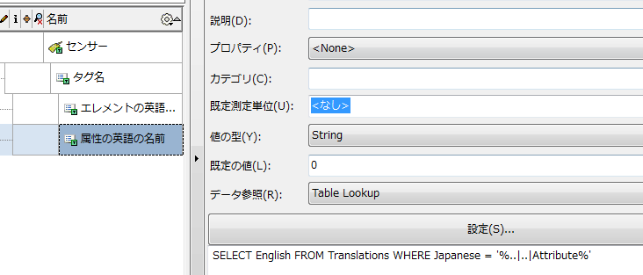
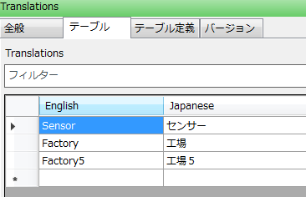
How to do so:
A table that handles all the translations.
Underneath a tag naming attribute, you add SQL references to look up each pieces of the translations.

Slide 25
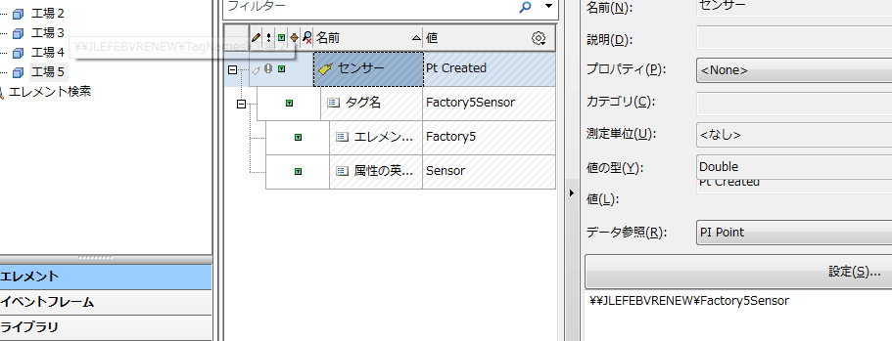
Result:
Resulting tag name: Factory5Sensor

Slide 26
Pros
Cons
Gives good tag names.
Compared with abusing the description field, no lose of AF features
Doubles the effort of creating an element
Requires good understanding of AF.

Slide 27
Method: Give up on tag names
Give up on meaningful tag names and simply give them a unique identifier.
Instead store the relevant information into the descriptor field of AF.

Slide 28
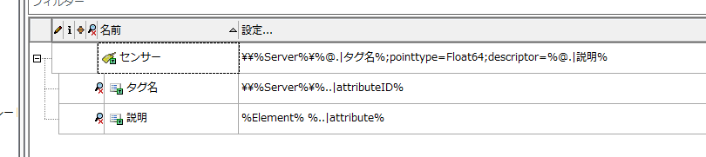
How to do so:
The tag name is simply the attribute ID
The information about the tag is stored in the descriptor field

Slide 29
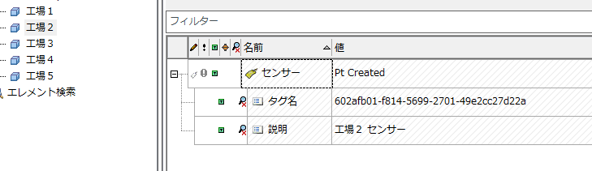
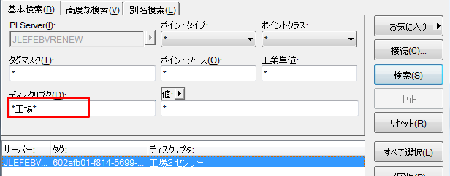
Result:
Gives a non-meaningful tag name, but possible to search for the tag using Japanese
Resulting tag name: 602afb01-f814-5699-2701-49e2cc27d22a

Slide 30
Pros
Cons
Great for new customers
Easily to implement
Harder to manage tags.

